Slide 1
Service Level Agreement for Continuous Delivery Service
DevOps Task Force
Delivery Competency
Global Application Delivery Center
04.2017

Slide 2
Revision History
Ver. | Descriptions | Date | Revised by
1.0 | Initialized | 1st Apr. 2017 | Zou, Chen

Slide 3
Table of Contents
Introduction
CD Env. Definition
CD Service Definition
CD Service Description

Slide 4
Acronyms & Definitions
Term | Definition
Working Day | Working day of SGS China working calendar
CD | Continuous Delivery
CI | Continuous Integration

Slide 5
1.Introduction

Slide 6
Introduction(1/2)
This Service Level Agreement (SLA) is the document to agree management service of continuous delivery service in SONY group.
Customer | Delivery teams in SONY group
Owner | Delivery Competency of Global Application Delivery Center (He Lei)
Service provider Div. | Continuous Delivery team of Global Application Delivery Center

Slide 7
Introduction(2/2)
Purpose of SLA
The purpose of SLA is to optimize IT service quality and cost by clarifying contents and level of the IT service to be provided and also to make communication efficient.
Revision of SLA
This SLA shall be revised in each year for its contents based on DC internal reviews to fit the business requirements.

Slide 8
2.CD Env. Definition

Slide 9
What is CD Env.
CD(※1) Env. (Continuous Delivery Environment) is an automation integration environment including automation compile, automation static analysis, automation unit test, automation integration test, automation deployment.
※1 https://en.wikipedia.org/wiki/Continuous_delivery

Slide 10



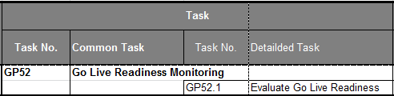

Continuous Delivery Image
DC provides technical solution of manual approval, but delivery teams need to decide operation procedure in line with governance rule.
Approve manually
Automatic
QA
Coding
Inspect
Build
Unit Test
Integration Test
Deployment
UAT
Automatic
PRD
Continuous
Delivery
GCM
Repository
Automatic
It is necessary to keep manual approval to keep aligned with governance rule such as GCM, CICR.

Slide 11
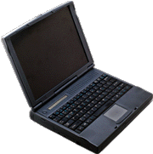


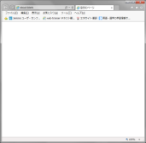
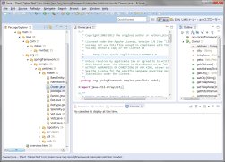
Configuration Diagram for CD Env.
PJ team needs to procure PC and install Selenium Server.
Selenium
Server
Docker based on CD Env
Redmine
(Common)
SonarQube
Jenkins
Java
Selenium
Junit
Maven
Delivery via manually approval
Target Server for Deployment
Browser
cAdvisor(optional)
(Monitor)
OS
(Linux)
SVN Server
Eclipse
(Junit)
Master SVN
(Prod Env.)
Master SVN
(QA Env.)
Need confirm the information to connect SVN server to SVN support team.

Slide 12
Tools list of CD Env.(for Java)
Tool Category | Product name | Remarks
CI tool | Jenkins | Jenkins is a Continuous Integration server. It can control other tools’ execution.
Development Language | Java
Build | Maven
Unit Test | JUnit
Coverage Check | Jacoco | The result is shown on SonarQube.
Static code analysis | SonarQube | Only for Java
Function Test | Selenium | PJ teams need to procure and setup Slave Selenium Server.
Deployment | Jenkins | 1.Call Shell on schedule 2.Manual/automatic approval

Slide 13
3.CD Service Definition

Slide 14
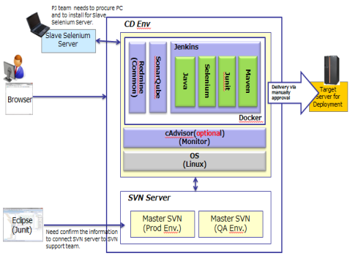

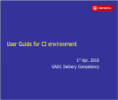


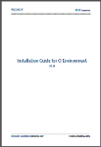
CD Service definition[1/2]
TF
 | CD Verification Env. | Docker based CD package
Detail | Build a CD verification Env. on GDC in order to help team members to investigate/test CD Env. | Provide installation & operation manual and Docker based CD package in order to support teams to build their own Env.
Objective | 1.Reduce the learning cost for CD Env. 2.Popularize CD Env. | 1.Evangelize automatic tools according to CD Env. 2.Reduce the cost of building CD Env.
Image
Project1
Project1
Docker based CD package
Project2
Project2
.
.
.
supporter
.
.
.
.
.
.
.
.
.
CD verification Env.

Slide 15
CD Service definition[2/2]
TF
 | CD Verification Env. | Docker based CD package
Attention points | - | Delivery teams need to handle CICR, security, FW application, server cost, server maintenance etc. once individual Env. is established.
 | DC provides S&M service for CD verification Env., container package, and take related infrastructure cost. Irresolvable issues (e.g. N/W connection issue, security issue and so on) can be expected due to connection from different domains to CD Env.
Scope of Service | Operationally there is no specific limitation on CD utilization from anyone within Sony Group. But technically there might be constraint by security issue, network issue, etc.
※ Public cloud (like AWS etc.) service is not provided. But you can refer to public cloud own CI/CD service.

Slide 16
Basic Service
Service categories | Service Menus | Descriptions
Standard service request | CD verification Env. request | Provide CD Verification Env. to delivery team depending on CD “Verification Env. Usage Flow”.
 | Docker based CD package | Provide Docker image and automation tools Provide installation and operation manual. Provide installation support if necessary. (Need to discuss cost) depending on “individual CD Env. setup flow”
Incident handling | Incident reception | Respond to delivery team’s inquiries via the Continuous Delivery team .
 | Failure or various information notification | Notify system failure or maintenance information related to delivery team at home page.
Service Continuity | Software modification | Handle or modify software failures or bugs depending on judgment of owner and Continuous Delivery team.
 | Back up | Backup service of CD verification Env. is not provided
 | Software update | Update each software version depending on judgment of owner and Continuous Delivery team.
Reporting | Reporting | Regularly report the status of CD verification Env. status.
Change Request realization | Implement necessary Change Request | Implement necessary changes depending on judgment of owner and Continuous Delivery team. Customizing for CD verification Env. is not provided

Slide 17
CD Verification Env. Usage Flow
Delivery Team | Delivery Competency
①Send request for CD verification Env.
②Setup CD verification Env. (※1)
④Make investigation/test on CD Verification Env.(※2)
③Provide CD Verification Env to users
※1 Continuous Delivery team will finish setup for CD verification Env. in 3 working days, then give feedback to users.
※2 We provide CD Verification Env. of 3 months validity to delivery teams, Please contact us if you want to utilize this verification environment above 3 months.

Slide 18
Individual CD Env. Setup Flow
Delivery Team | Delivery Competency
①Download manual & docker from DC HP
②Build own CD Env. according to manual.
③Need installation support
Y
④Provide installation support(※1)
N
⑤Finish the building about CD Env.
※1 Need to discuss cost.

Slide 19
Basic Service Time
Basic service time | SGS China working calendar working day From 9：00 to 18：00
Service start date | 1st April, FY17
Basic work place | SGS China Dalian office
Information offering method | Continuous Delivery team e-mail, documents, website
Contact | SGSCN-continuousdelivery-sm@sony.com.cn
Remarks
N.B. : Service outside the basic service time is not provided due to no emergency inquiries or troubles as verification environment.

Slide 20
Service Organization Structure
Inquiry
Failure notice
Service request
Change request
Notifications
e-mail
e-mail
e-mail
e-mail
e-mail +
Website
Reception
System management organization
Continuous Delivery team
Roles and contact information
Roles | Department in charge | E-mail
Owner | Delivery Competency, GADC | GADC-ITSM-QA-Planning@ap.sony.com
Continuous Delivery team | Continuous Delivery team, GADC | SGSCN-continuousdelivery-sm@sony.com.cn

Slide 21
4.CD Service Description

Slide 22
Incident Handling
Service menus |  | Service level
Incident reception (Basic service time) |  | Assign persons in charge within 2 hours and send the first response within 2 hours.
Incident reception (Non service time) | Priority： Critical | Assign persons in charge within 1 hour and send the first response within 2 hours.
 | Priority： High | Assign persons in charge on the next working day and send the first response within 4 hours after the assigning.
 | Priority： Medium | Assign persons in charge and send the first response on the next working day.
 | Priority： Low | Assign persons in charge and send the first response on the next working day .
CD verification Env. is used for investigation or test, No Critical and High incident.
Service level | Incident resolution (Basic service time) | Incident resolution (Non service time)
Priority：Critical | Provide resolution within 4 hour. | Provide resolution within 6 hour.
Priority：High | Provide resolution within 6 hour. | Provide resolution within 10 hour.
Priority：Medium | Provide resolution within 2 working day. | Provide resolution within 2 working day.
Priority：Low | Provide resolution within 5 working day. | Provide resolution within 5 working day.
CD verification Env. is used for investigation or test, No Critical and High incident.

Slide 23
Incident Handling (Escalation workflow)
Impact degree |  | Critical | High | Medium | Low
Impact Definition |  | Have impact on Sony group’s core business(*), and requires immediate action because no alternate functions exist. | Have impact on Sony group’s core business but alternate functions exist, or, have impact on non-core business but no alternate functions exist and requires immediate action. | Have impact on delivery team staff test or investigation. Immediate action however is unnecessary. | Have no impact on to delivery team staff test /investigation.
Complete escalation Time |  | Office hour ： Within 1 hour After office hour ： Within 1 hour |  |  | Office hour ： Within 1 day After office hour ： Within 2 next working day
Escalation (Within IS ) |  | Team staff/SD staff → Dept Head (M) → Div Head (GM/AGM) → VP | Team staff/SD staff → Dept Head (M) → Div (GM/AGM) | Delivery team staff/SD staff → PL/PM | Delivery team staff/SD staff → PL/PM
 |  | Update status per 1 hours |  | Update status once a day | Update status once a week
Announce to End user/ (Biz side/Related IS staff) | Announce Timing | Office hour : within 1 hour After Office hour： within 2 hours | Office hour : within 2 hour After Office hour： within 2 hours after assignment
 |  | Update status per 2 hours
 | Announce Procedure | Office-hour: Service Desk => End User (Phone and e-mail)
 |  | Non-office-hour: APP level 2 PIC => End User (Phone and e-mail)
CD verification Env. is used for investigation or test, No Critical and High incident.

Slide 24
Service Continuity
Category | Contents | Definition | Frequency
Service Continuity | Software modification | Handle or modify software failures or bugs depending on judgment of owner and Continuous Delivery team. | Make judgment twice in each year by owner and Continuous Delivery team.
 | Software update | Update each software version depending on judgment of owner and Continuous Delivery team.

Slide 25
Reporting
■Meeting definition
Meeting | Cycle | Descriptions | Reports | Timing
Monthly regular meeting | Monthly | Share current CD verification Env. status. | Request list | 1st week
Annual report meeting | Annual | Confirming or approving the service contents for the next year. | SLA | Feb.
■Report definition
Reports | Contents
SLA | ・Creating the next year plan ・Revising service contents
Request list | Share projects information which is using/used CD verification Env.

Slide 26
Change Request Realization
■ Basically Change Request is handled by Change Advisory Board (CAB).
CAB member
CAB must be attended by the members shown below. Other people can attend the meeting when necessary.
Attendee | CAB Name
 | Solution Judgment meeting (Confirm Change Direction and Plan) | Plan Confirmation meeting (Confirm Implementation detailed Plan) | Go-live Judgment meeting (Confirm Prod. Env. Impl. Readiness)
Owner | Required | If Necessary | Required
PL | Required | Required | Required
S&M members | Required | Required | Required

Slide 27
5.Appendix

Slide 28
Continuous Delivery Team Structure
PL
Zou Chen
S&M team
Service Desk
Sun, Yongjie
Fan, Liang
Fan, Liang(Act)※
Sun, Yongjie(Act)
※Main PIC

